Slide 1
AI Producer
Democratizing Production with Microsoft Teams

Slide 2
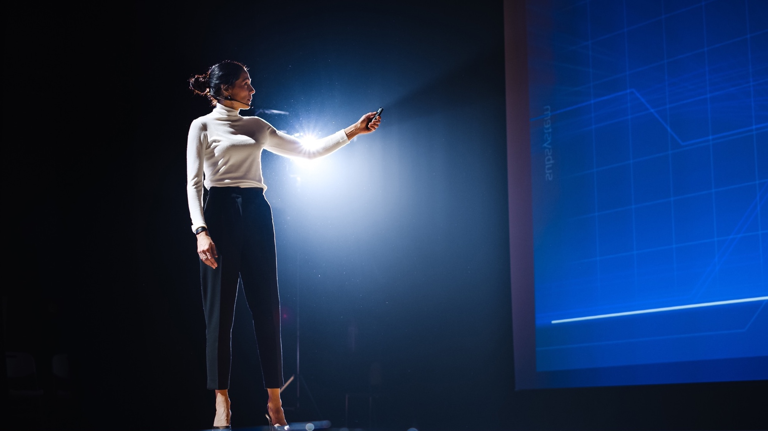

Engaging and sharing information using video, has never been more important.
AI Producer is the powerful easy-to-use tool that allows you to do this, without the need for technical expertise.
HYBRID WORK
There are over 270M monthly active users with Microsoft Teams.
53% say their organizations have standardized on Microsoft Teams. 67% say they expect to standardize on Microsoft Teams in the next 3 years.
54% of leaders say their company is investing in tech and space to redesign meeting rooms to make them more hybrid-friendly.
CHALLENGES
Hybrid work is here to stay and producing compelling presentations and live events will be extremely important to capture viewer’s attention.
But it’s been complicated – requiring a mix of costly hardware, complex software solutions, skilled professionals or external production teams.
IDEAL SOLUTION
Use AI Producer for live webinars, Townhall meetings, interactive events, and broadcasts. Without leaving Microsoft Teams.
Use AI Producer to Play high-quality video in meetings. Or create vivid productions in the same meeting or for later viewing/sharing.
All fully automated without the need for extra hardware or production staff.

Slide 3
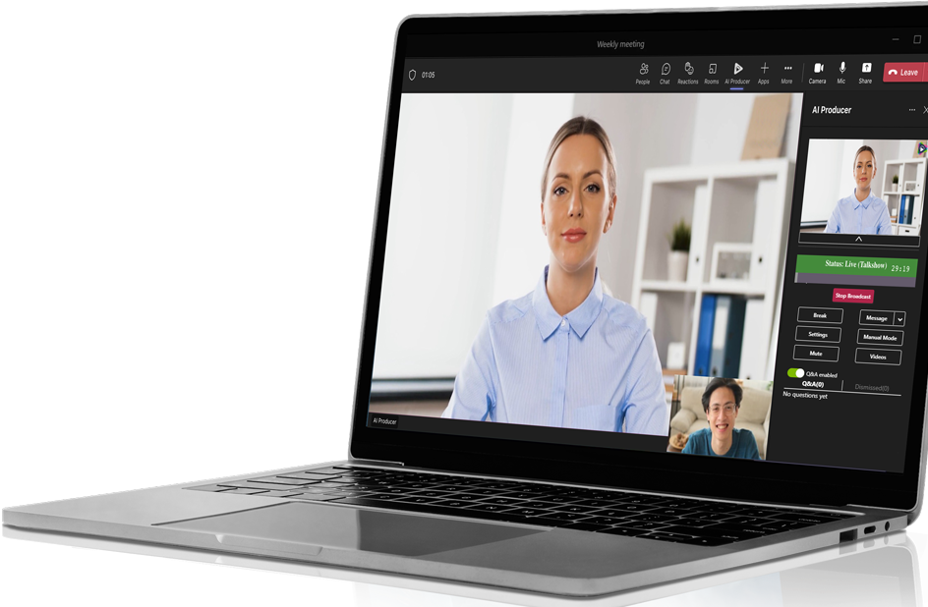
AI Producer for Microsoft Teams
Integrated in Microsoft Teams as a meeting extension app.
Enhance your Teams meetings including
Play high-quality video.
Fully automated productions and broadcasts.
Preset Production formats that suit your needs.
Brand your production with a logo and background.
AI Producer will automatically create a vivid and engaging production.
Viewers can follow the production in Teams meeting, Teams webinar, Teams live event, LinkedIn or any other distribution platform of
your choice.

Slide 4
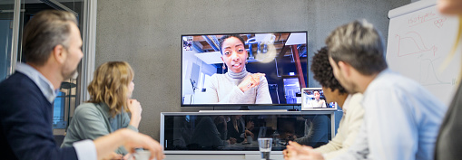



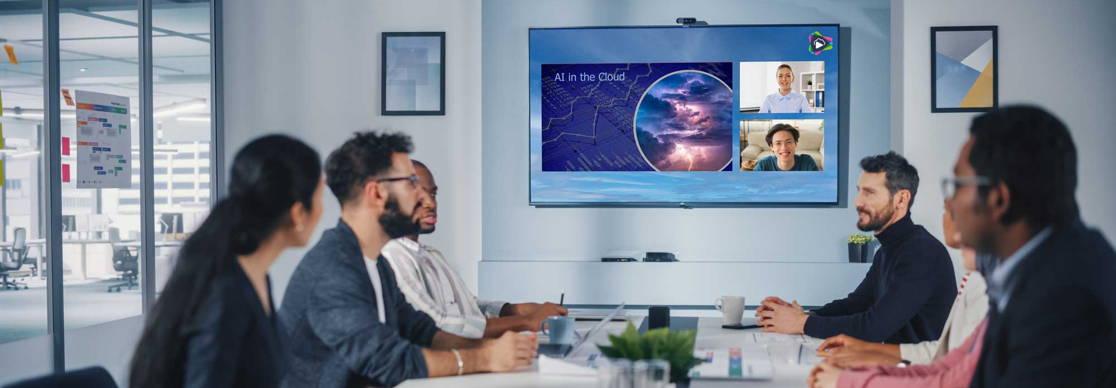
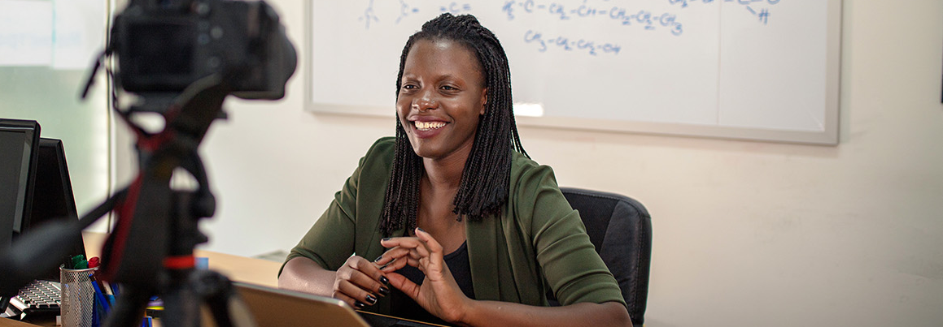
AI Producer Meeting
Enhance your Teams meeting’s experience
Play high-quality video in your Teams meetings. Or automatically produce your presentation, lecture or panel discussion in a more vivid and engaging way. In the same meeting. Or save it or for later viewing and/or sharing.
Playout video
Play high-quality video in Teams meetings and stop worrying about videos not loading. Play your personal Playout video library from anywhere, regardless of limitations in local bandwidth.
Produced Meeting
Save your meeting, produced in a vivid and engaging way for later viewing and/or sharing.
Analyzes constantly who is speaking and the shared screen. Displays in Focus mode, Shared, and Split-screen.
Same meeting destination
Enhance your meeting with a production to the same meeting or webinar. (available Q2)
Education
Optimized for one presenter at a time. Analyzes constantly the presenter and the shared screen. Displays in Focus mode, Shared screen, and Side-by-side modes. Designed following GDPR, where students/attendees remain anonymous.
Notes:
Education, är nog inte rätt animeringar för formatet. //Jag tror att det är rätt, iaf samma som vi haft tidigare/JE
Same meeting destination, svårt att se texten i bilden, gäller på sätt och vis alla dessa texter i bild

Slide 5
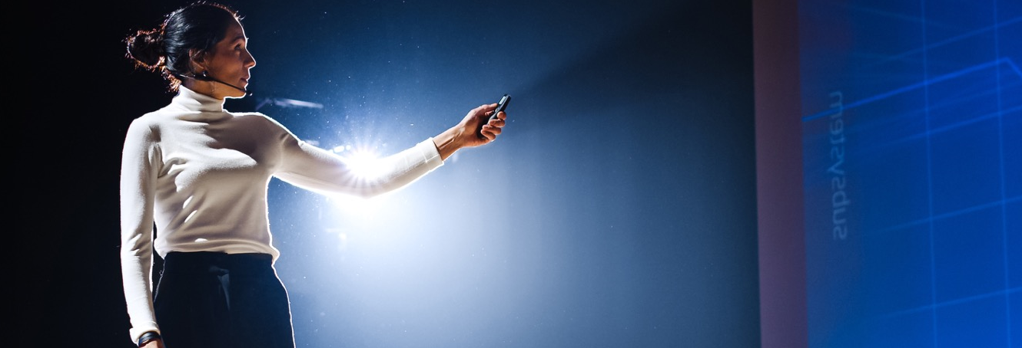
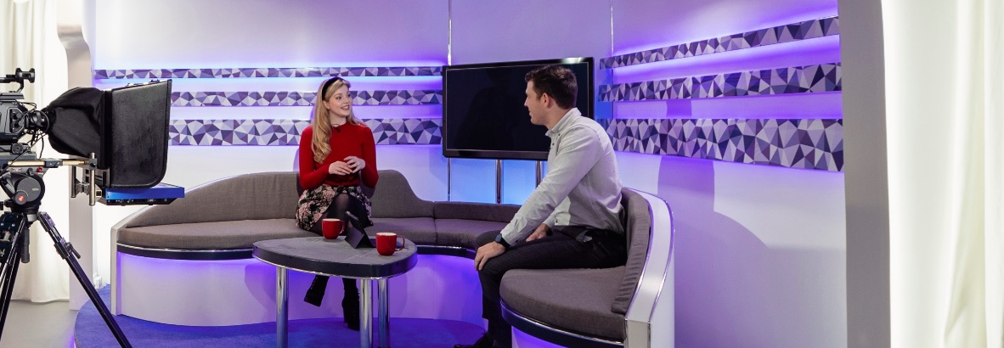

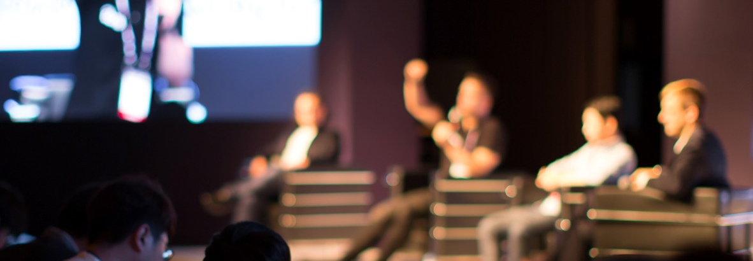
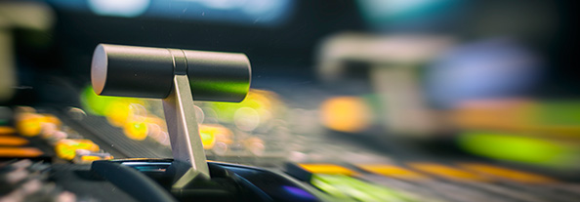

AI Producer Broadcast
Broadcast live to any destination
Easily broadcast your Webinars, Live Events, Town Hall meetings etc. Fully automated or you take control in Manual Mode. Use preset production formats or use Rundown with different segments to get a smooth interesting production.
Presentation
Optimized for one presenter at a time. AI Producer constantly analyzes the presenter and the shared screen. Displays in Focus and Side-by-side modes.
Talk Show
Supports several presenters. Displays presenters individually in Focus mode or together in Split-screen.
Panel Discussion
Supports several presenters and a shared screen. Displays in Focus mode, Shared and Split-screen.
Rundown
Take advantage of the strength of the different Preset Production formats.
Combine them easily into a smooth broadcast Rundown schedule.

Slide 6

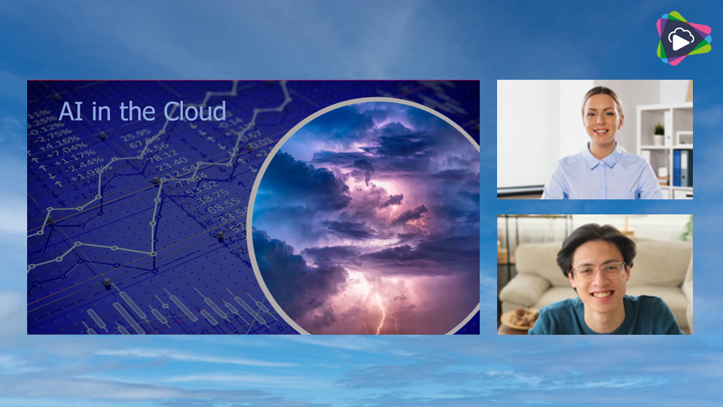
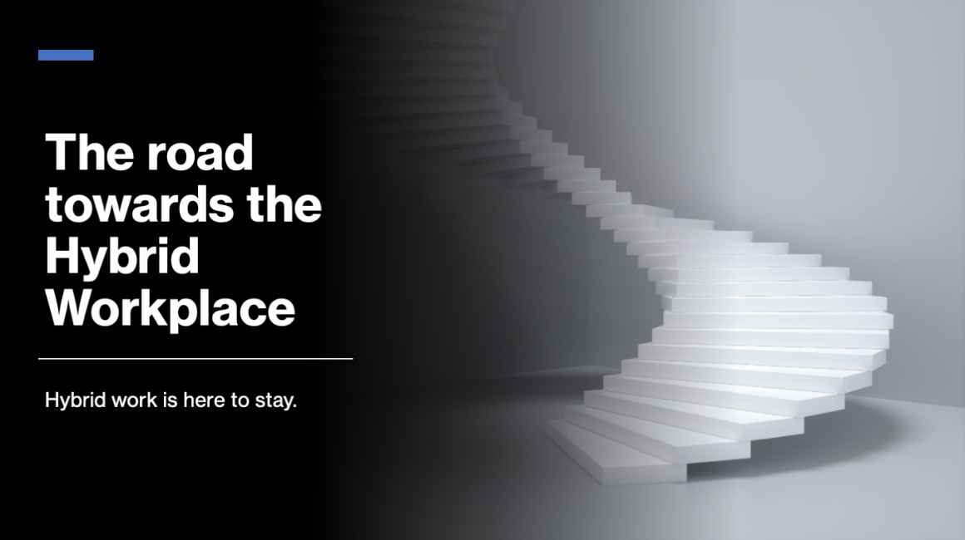
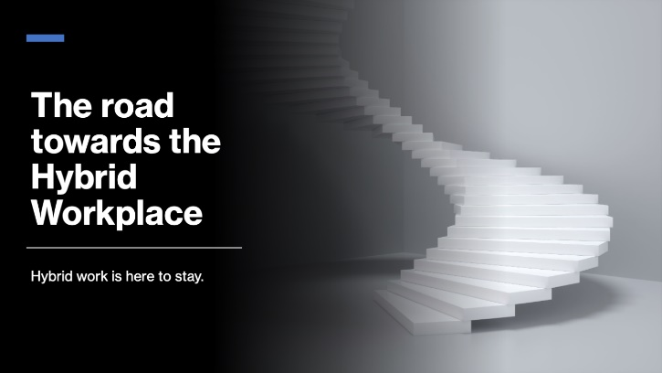

Automated production
During the broadcast, AI Producer analyzes the action and then cuts automatically between presenters and shared screens. No production staff is needed.
Focus mode – Presenter
Split screen
Focus mode – Shared screen

Slide 7



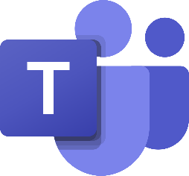
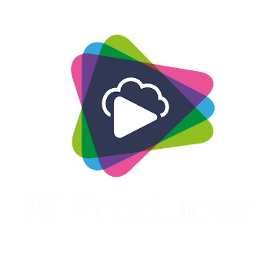





AI Producer – Solution Overview
SaaS or Managed Application
Remote
Microsoft Azure
Audience
Microsoft Teams
Cameras and
Screen Share
Microsoft
Teams meeting
Teams webinar
OneDrive
Teams live event
Yammer
Record/Broadcast
On-Prem
Video
Converter
Other services
Camera
LinkedIn
YouTube
Workplace from Meta
Etc.
Microsoft Teams Rooms

Slide 8


AI Producer – Use cases
Enhance your Teams meetings
Broadcast live to any destination
AI PRODUCER MEETING
AI PRODUCER BROADCAST
  Playout Video
    Play high-quality video in Teams meetings.
    Personal Playout video library.
    Produced meeting
    Save your meeting, produced in a vivid and engaging way for later viewing and/or sharing.
  Same meeting destination (available Q2)
    Enhance your meeting with a production in the same Teams meeting or Teams webinar.
  Education
    Save a produced version of your lecture or presentation. Designed following GDPR, where students/Participants stays anonymous.
Live Broadcast
Easily broadcast your Webinars, Live Events, Town Hall meetings etc. Fully automated, with a few clicks from inside Microsoft Teams.
Use preset Production formats branded with your logo, backgrounds and name overlays.
Send to multiple destinations, such as Teams meetings or webinars, Teams Live Event, LinkedIn or any other destination.
  Pre-Production
  Create your own pre-produced videos.
  Production in the cloud
  AI Producer is your producer – or you take control in Manual Mode.
  Advanced features such as, Q&A, Rundown, Custom Layouts, Additional Cameras and Advanced Overlays.
  Easy; no extra hardware or staff needed.

Slide 9




AI Producer by LiveArena Technologies
www.livearena.com
sales@livearena.com
Aquire and access via Microsoft Azure and Microsoft AppSource

